Slide 1
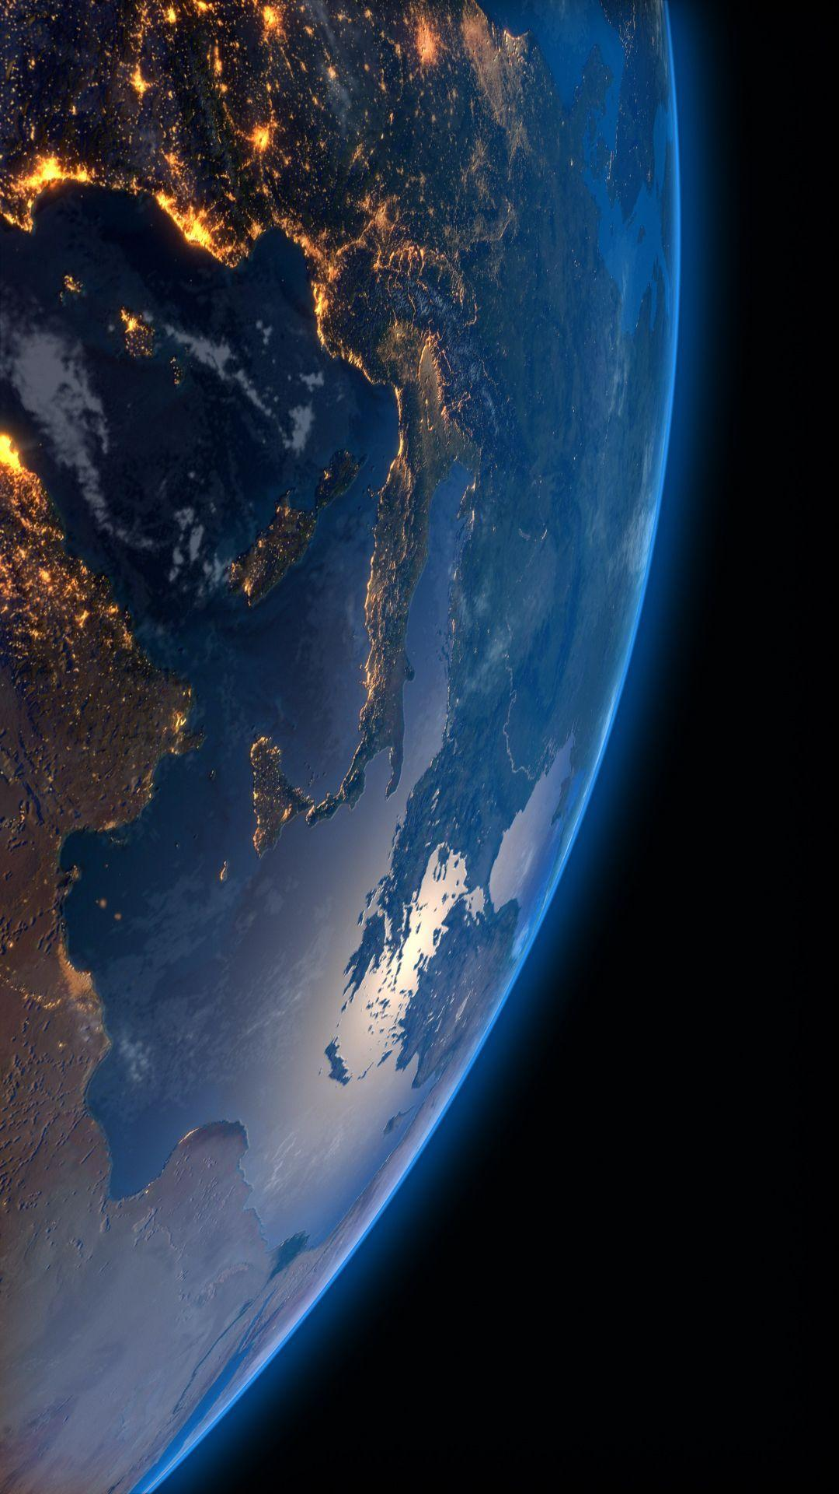
HOW TO CATCH A PLANET?
(I can’t believe I woke up in time for this)

Slide 2
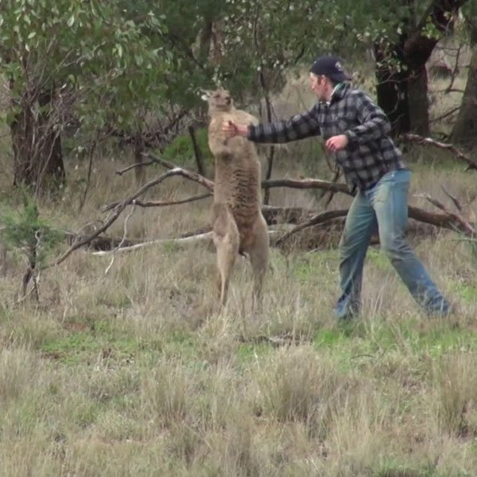
WHY DETECT PLANETS?
We seem to be having a grand old time here

Slide 3
POP QUIZ
When did we detect the first exoplanet around a Sun-like star?
1873
1968
2006
1995
The Earth is flat

Slide 4
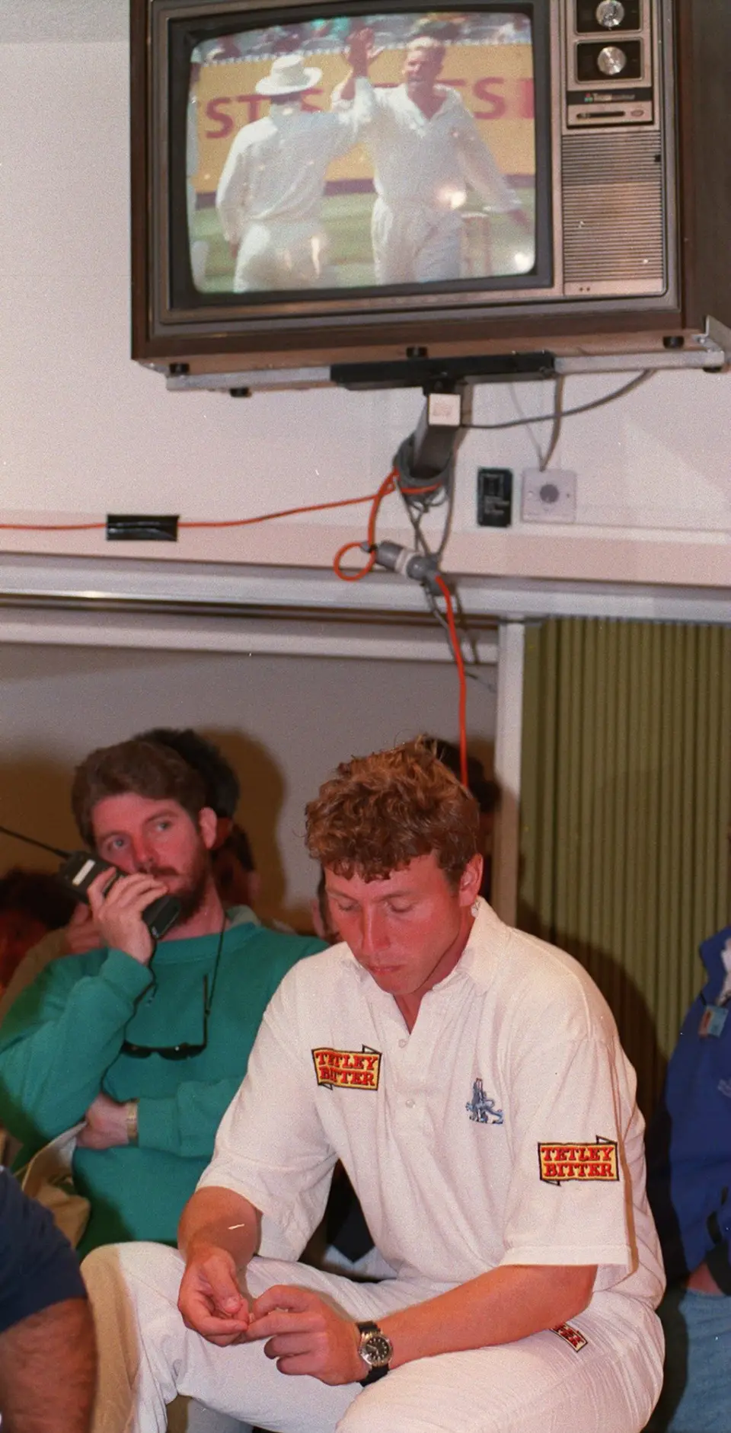

POP QUIZ
When did we detect the first exoplanet around a Sun-like star?
1873
1968
2006
1995
The Earth is flat
Also the year we won (“retained”) the Ashes 3-1
Chew on that Mike Atherton
Wanker

Slide 5
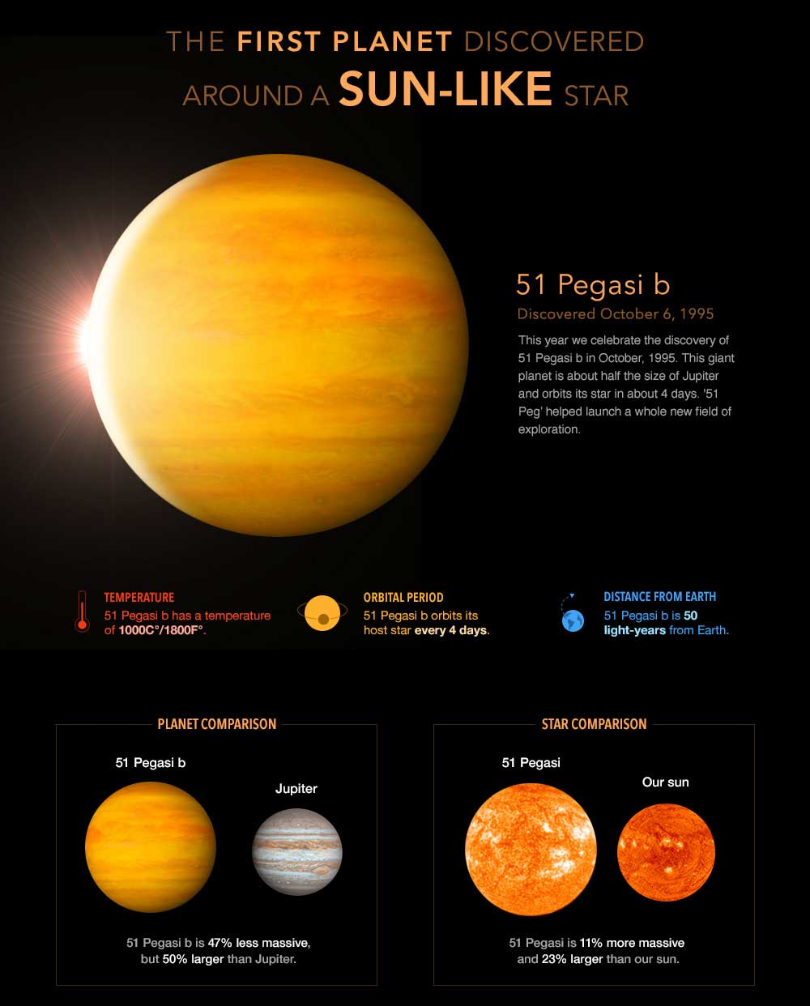
51 Peg b

Slide 6
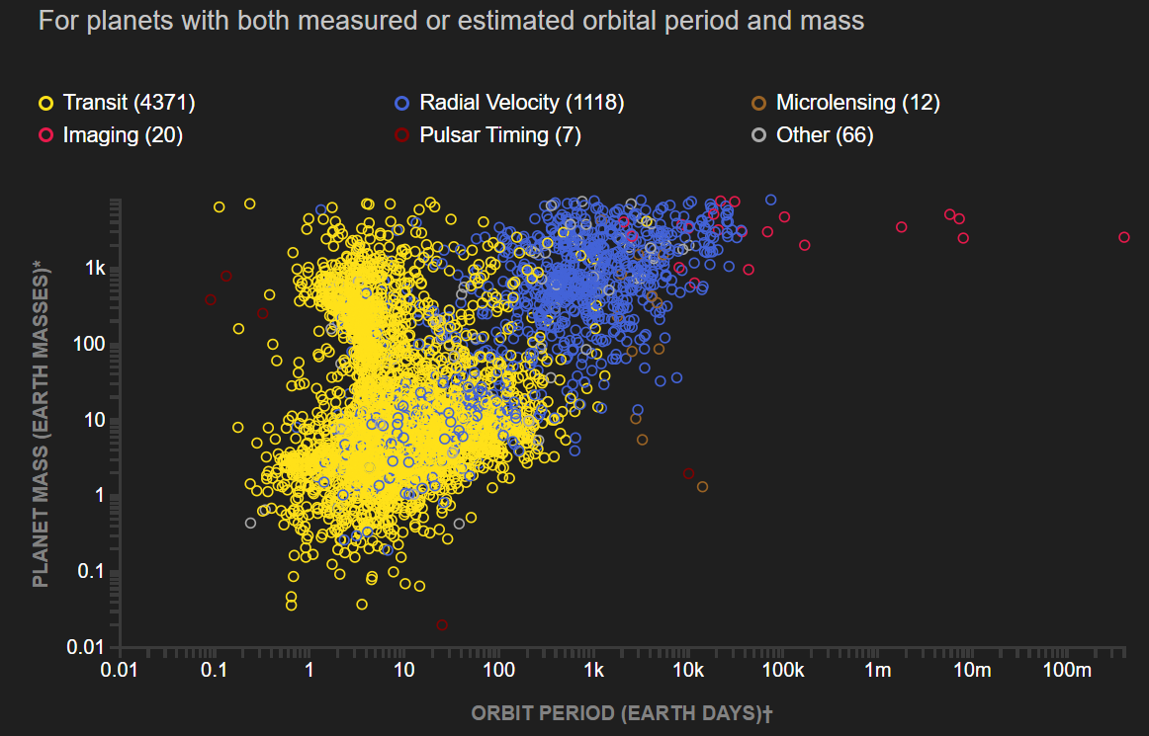
We’ve found a few more

Slide 7
Planet Detection Methods
Direct Imaging
Transits
Radial Velocity
Microlensing
Pulsar Timing

Slide 8
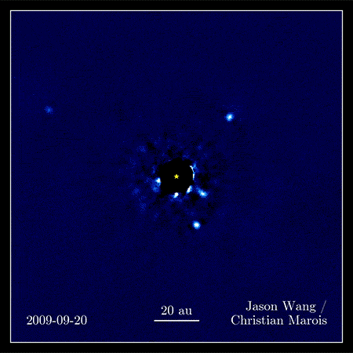
DIRECT IMAGING
Point the f*cken telescope and hope🤞

Slide 9
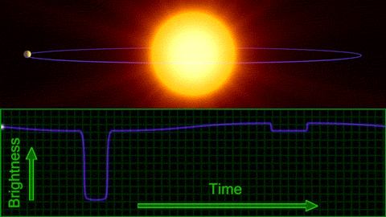
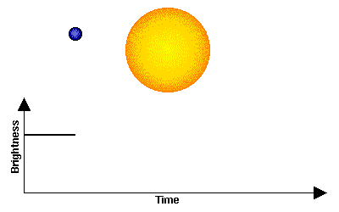
TRANSITS
Point the f*cken telescope and hope it aligned perfectly at the perfect time🤞

Slide 10
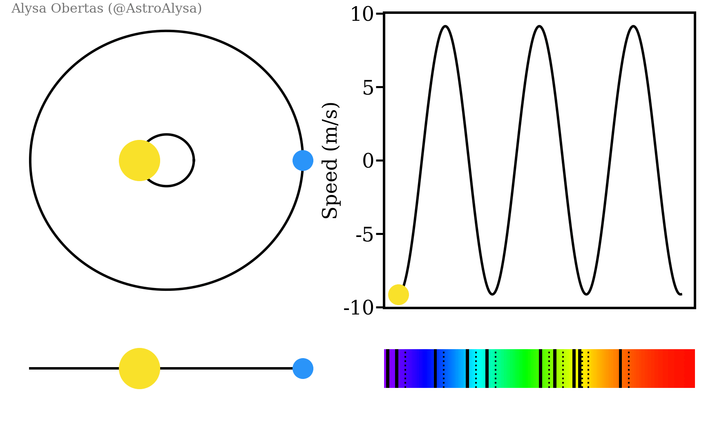
RADIAL VELOCITY
Stare at the star, hope it wobbles, and convince yourself it’s not noise

Slide 11
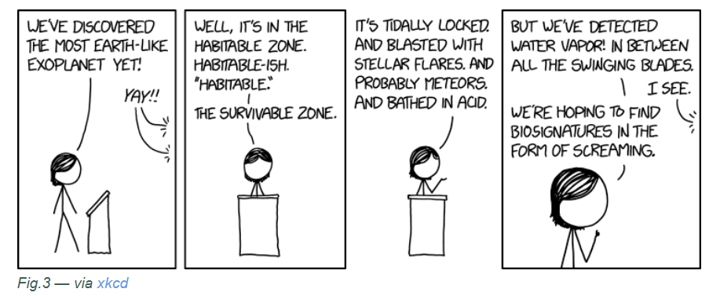
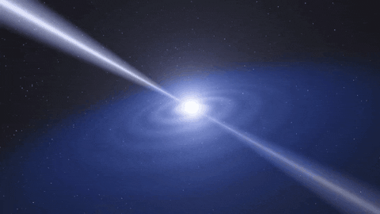
PULSAR TIMING
Best method to detect habitable exoplanets?

Slide 12
How do you gaslight a group of astronomers?
Microlensing – We saw this weird blip once, the math checks out, but the star kept moving and is now gone forever. …. But trust me bro, it was there

Slide 13
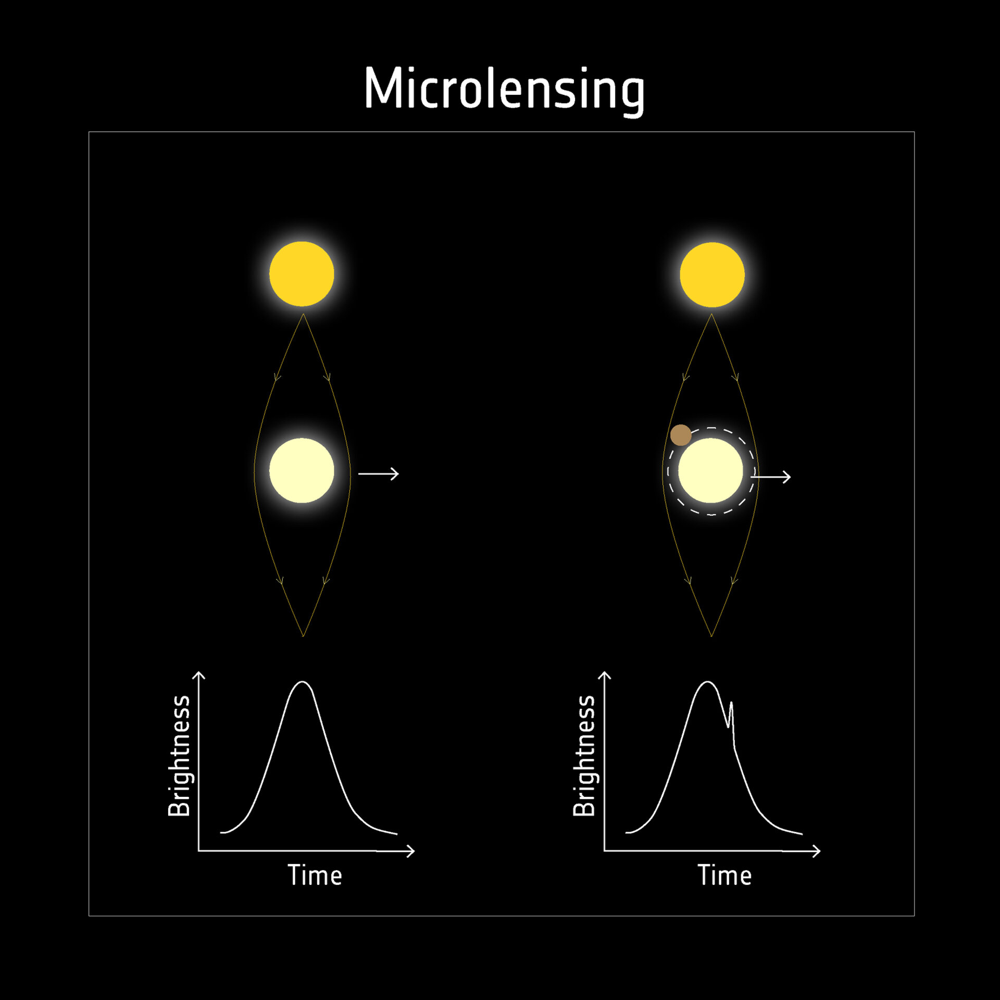
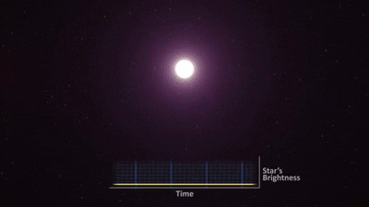
MICROLENSING
The planet detection equivalent of “Source – Trust me bro”

Slide 14
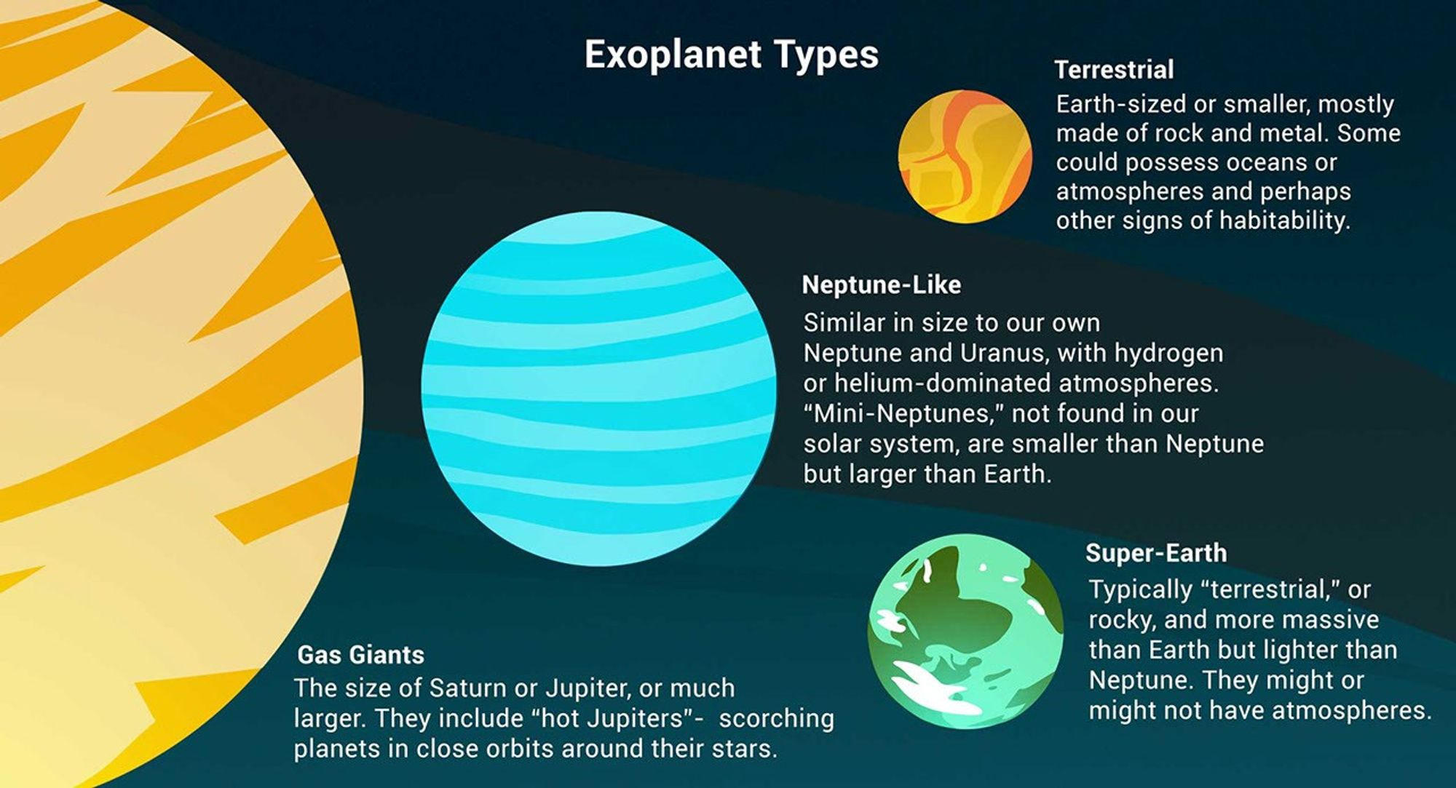
PLANET TYPES

